Slide 1
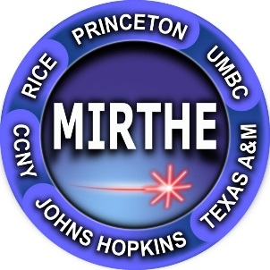

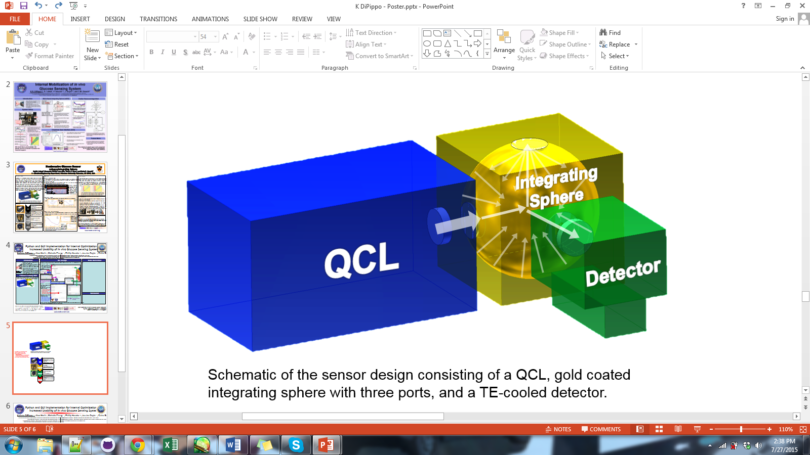
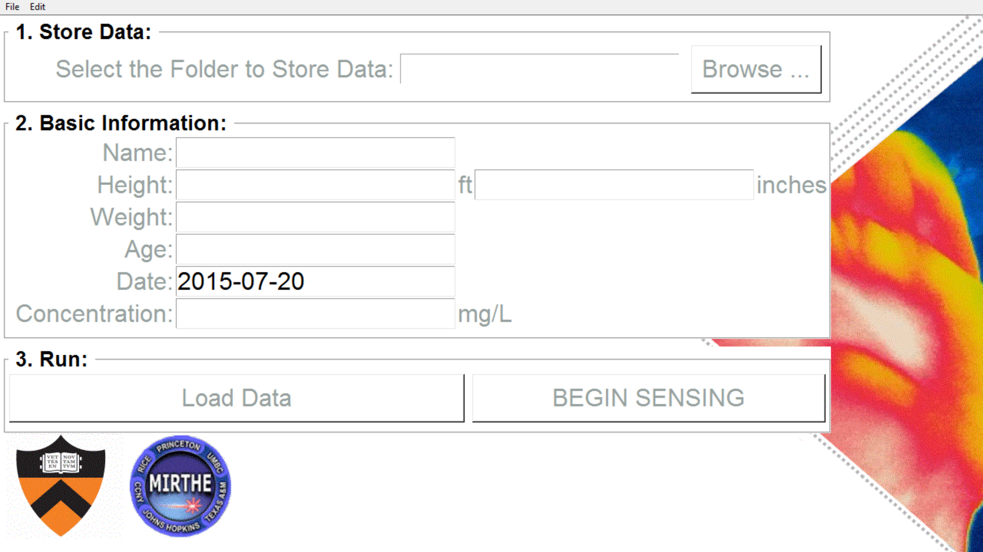
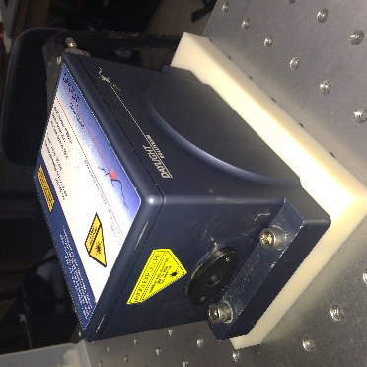
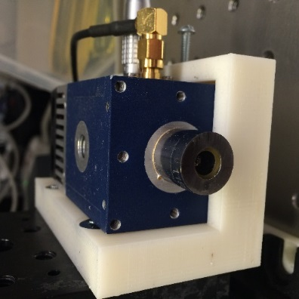
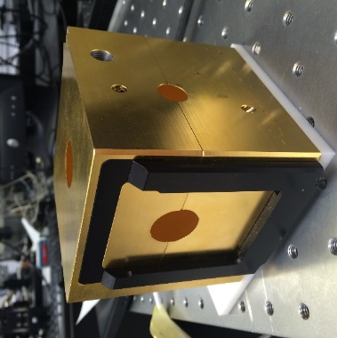
Python and GUI Implementation for Internal Optimization and Increased Usability of in vivo Glucose Sensing System
Kathryn DiPippo^{1,2}, Alex Werth¹, Michelle Zhang^{1,3}, Phillip Heucke^{1,4}, Jessica Doyle^{1,5}, Claire Gmachl¹
1 – Princeton University Department of Electrical Engineering, Princeton, NJ, 08540, USA
2 – Permanent Address: Rensselaer Polytechnic Institute, Troy, NY, 12180, USA
3 – Permanent Address: Smith College, Northampton, MA, 01063, USA
Industry / Practitioner Collaborators: Daylight Solutions Inc. Zurich Instruments
4 – Permanent Address: Bucknell University, Lewisberg, PA, 17837, USA
5 – Permanent Address: Hunterdon Central Regional High School, Flemington, NJ, 08822, USA
email: dipippo@princeton.edu / dipipk@rpi.edu
QCL
Integrating Sphere
Detector
Spectral Analysis
- GUI started up and populated with data
- Number of spectral runs are taken
- Various statistical analyses applied:
- Wavelet transform
- Savitzky-Golay Filtering with Differentiation
- Machine Learning Prediction Algorithm
- Final predicted glucose concentration
obtained

Slide 2
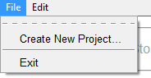
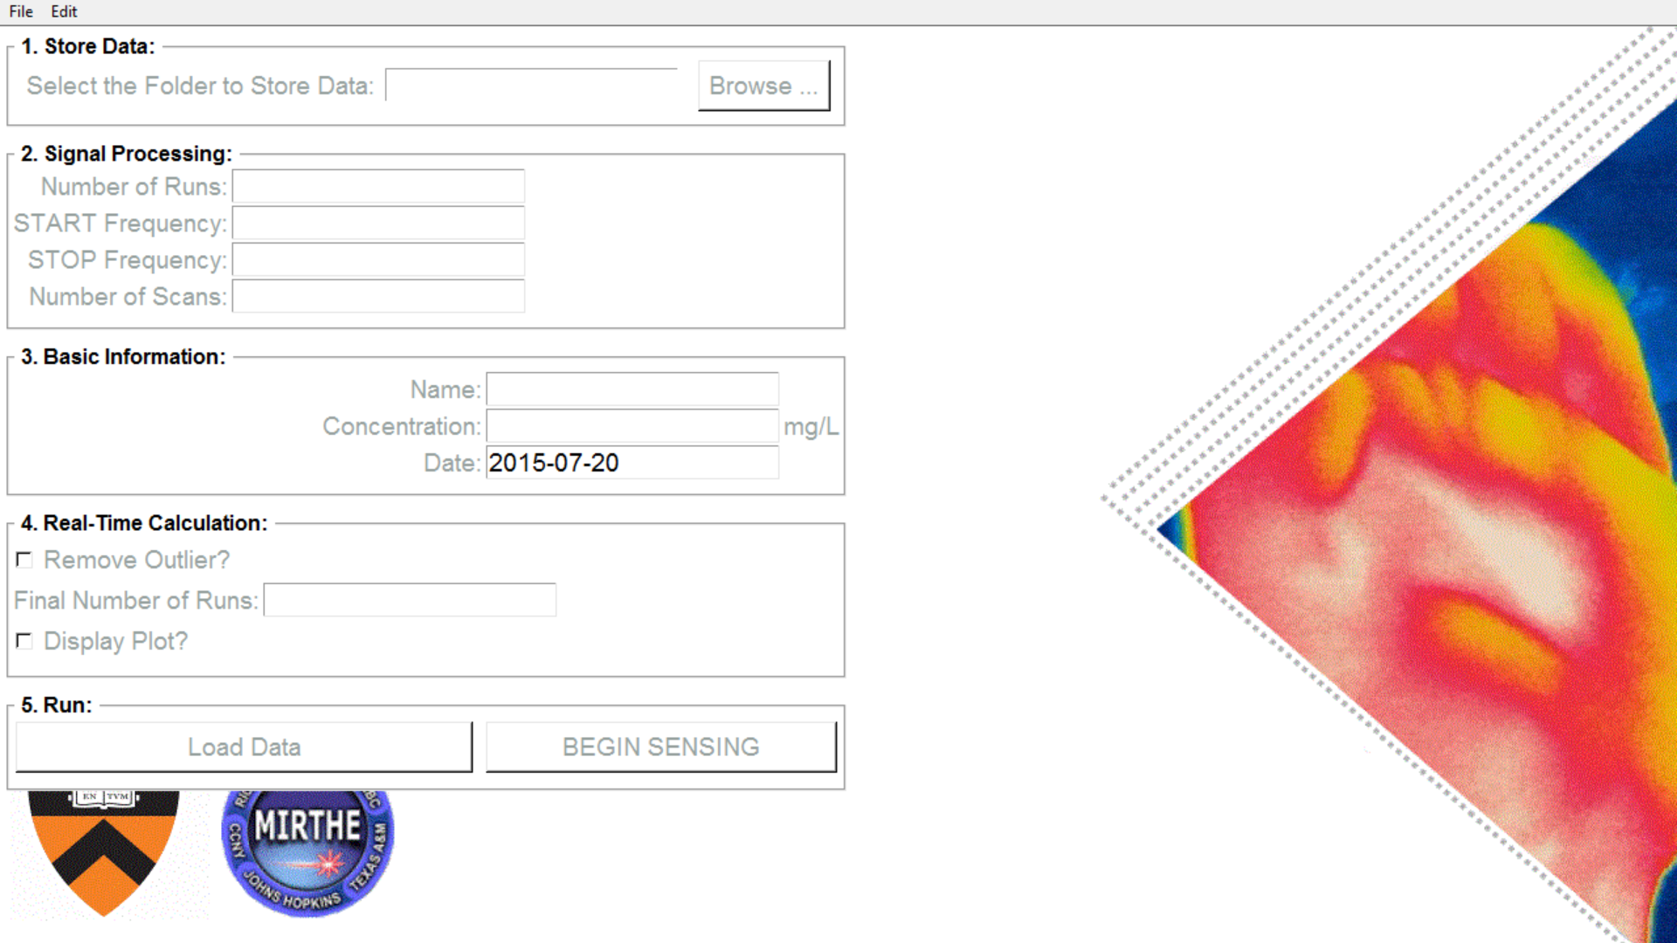
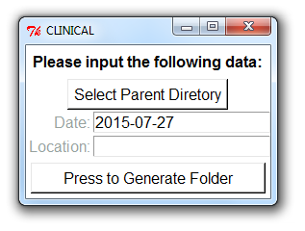
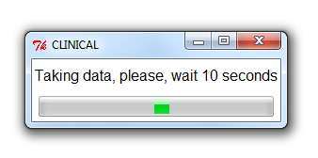
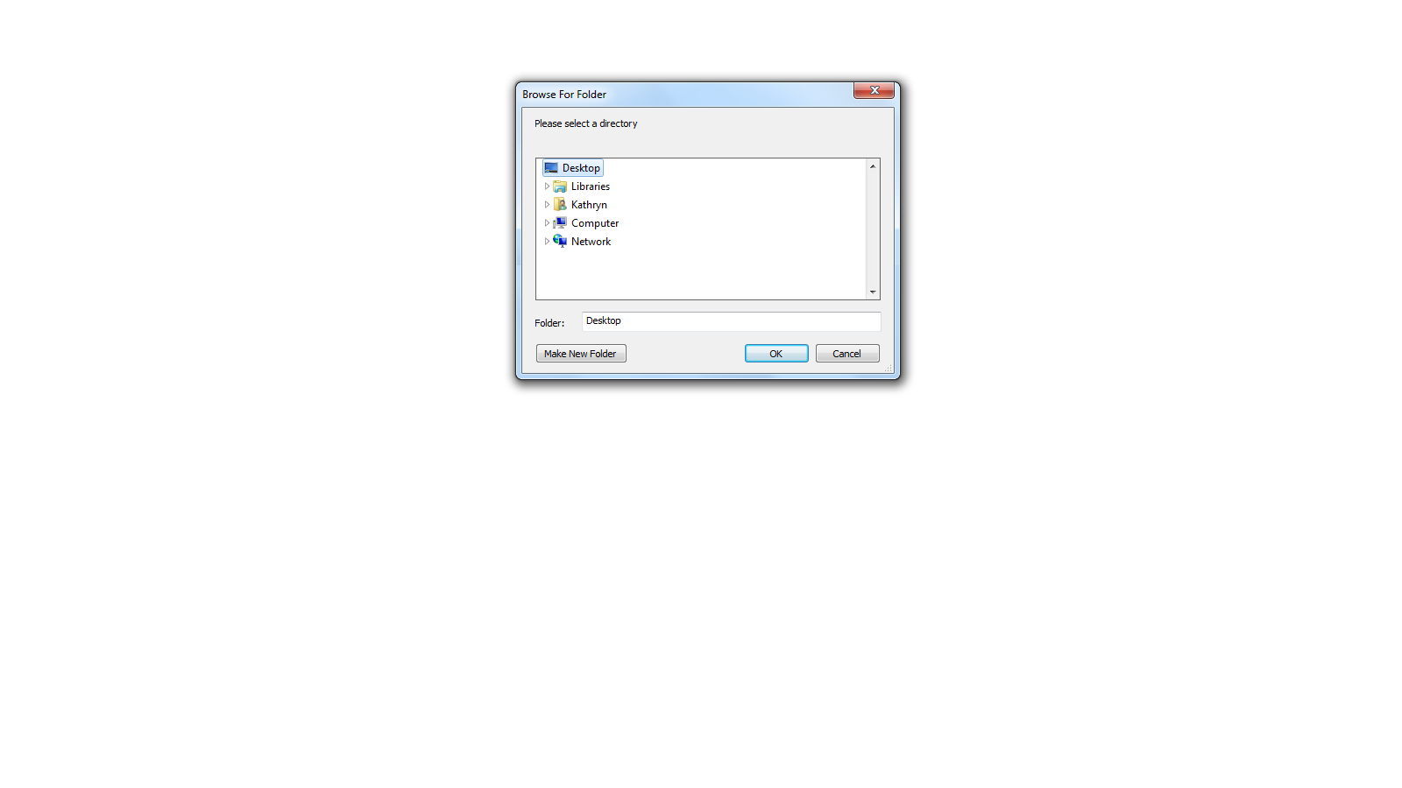
GUI – CLINICAL AND SOLUTIONS

Slide 3
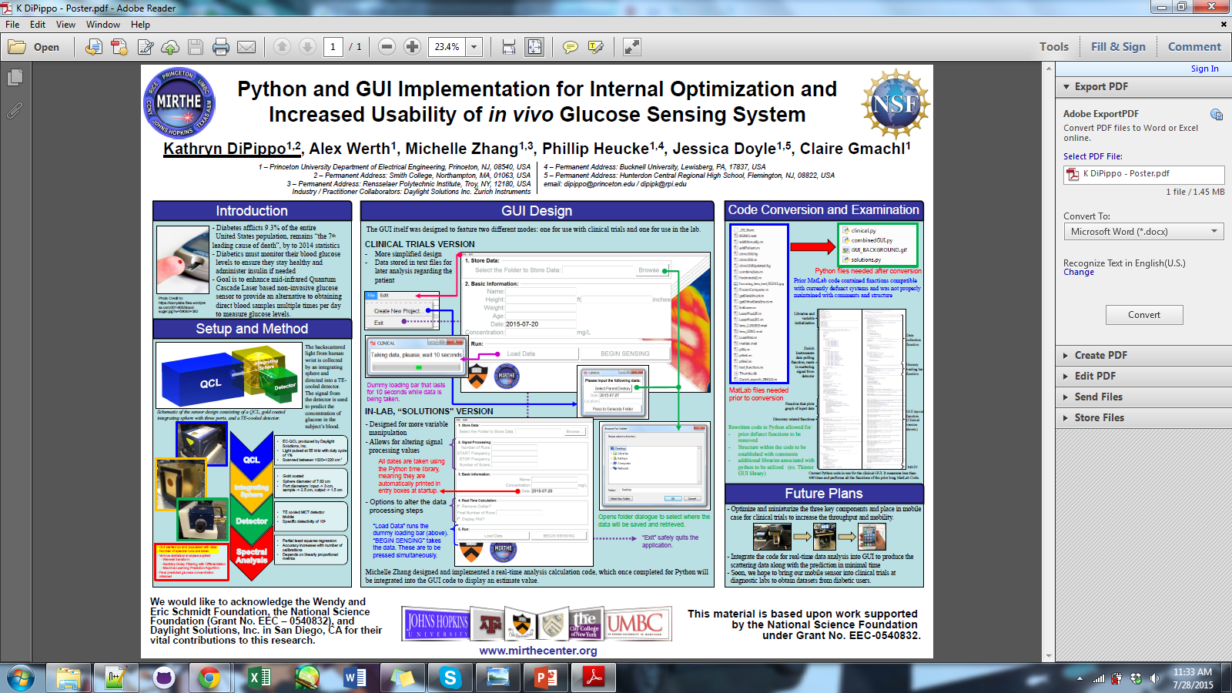
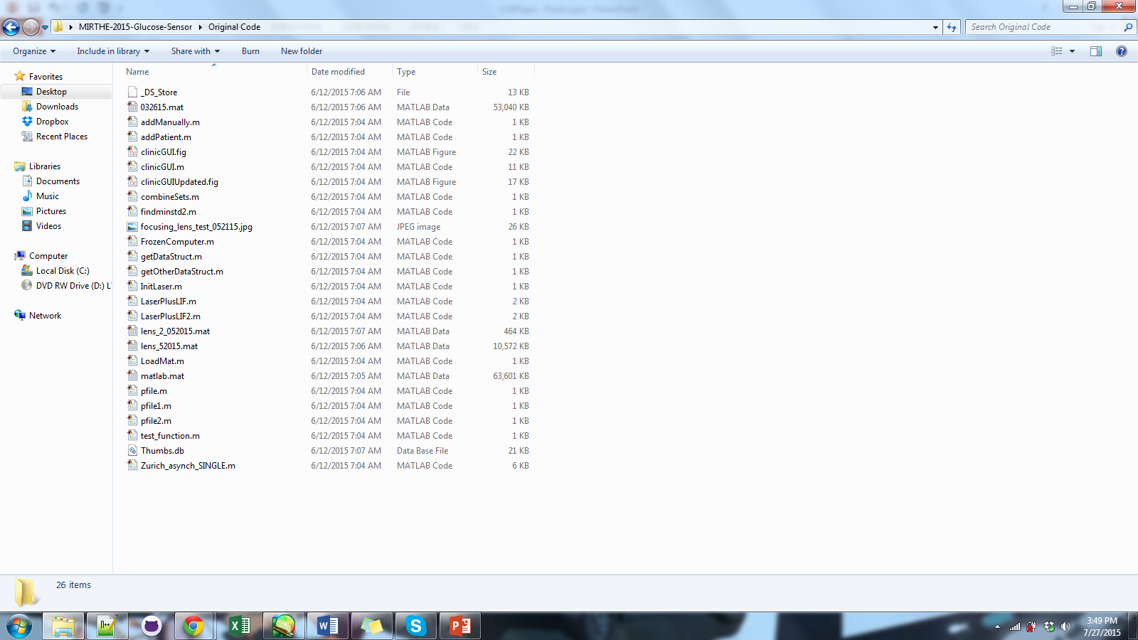
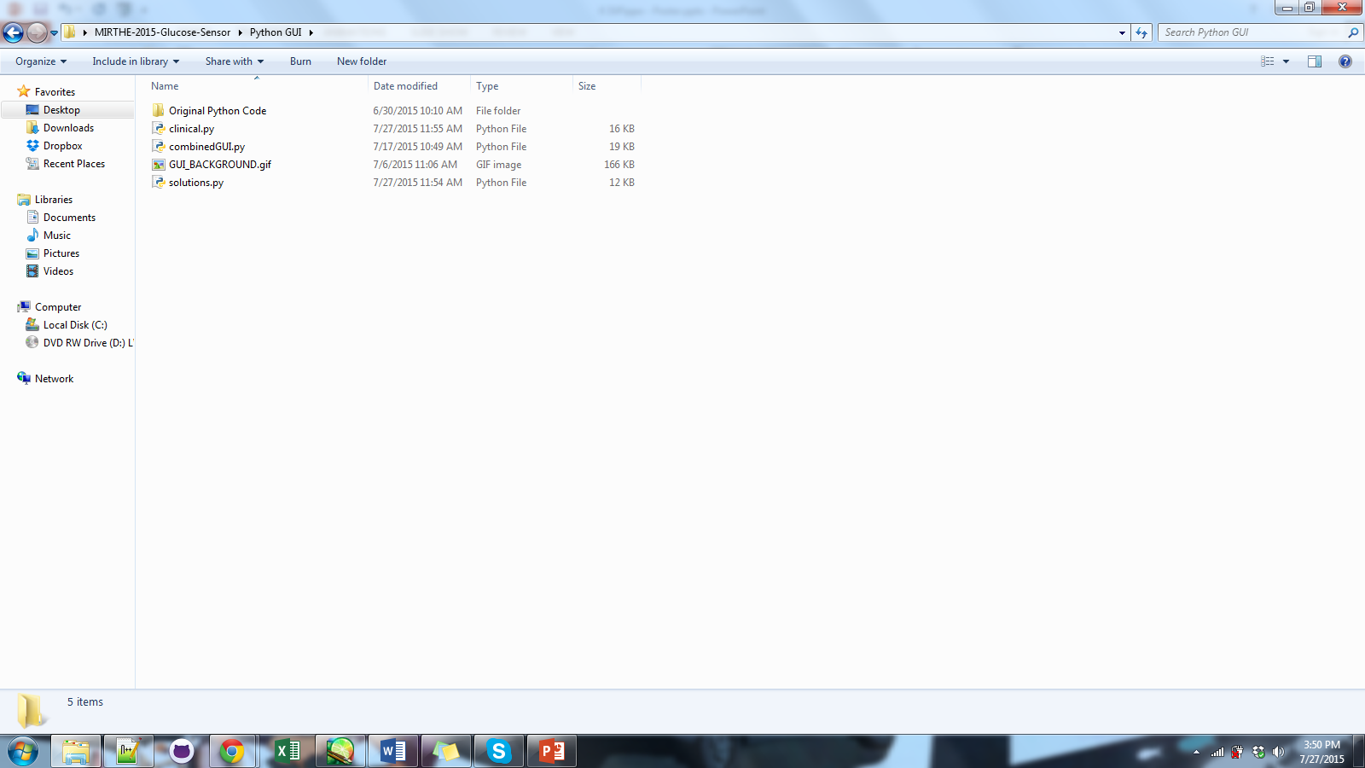
Converting MatLab to Python

Slide 4
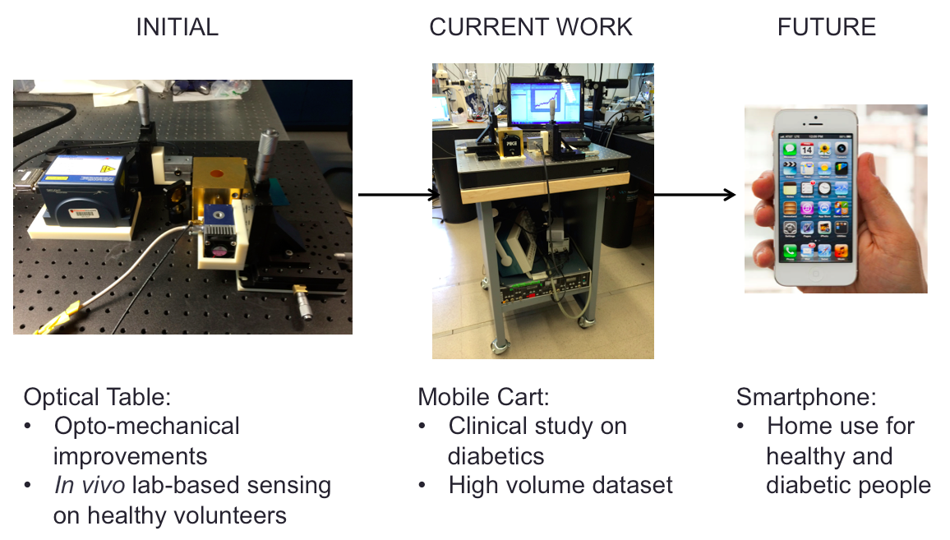
SEE ME AT POSTER #15

